Slide 1
Remembering Resistance #BlackCodeStudies SP17
February 7, 2017

Slide 2
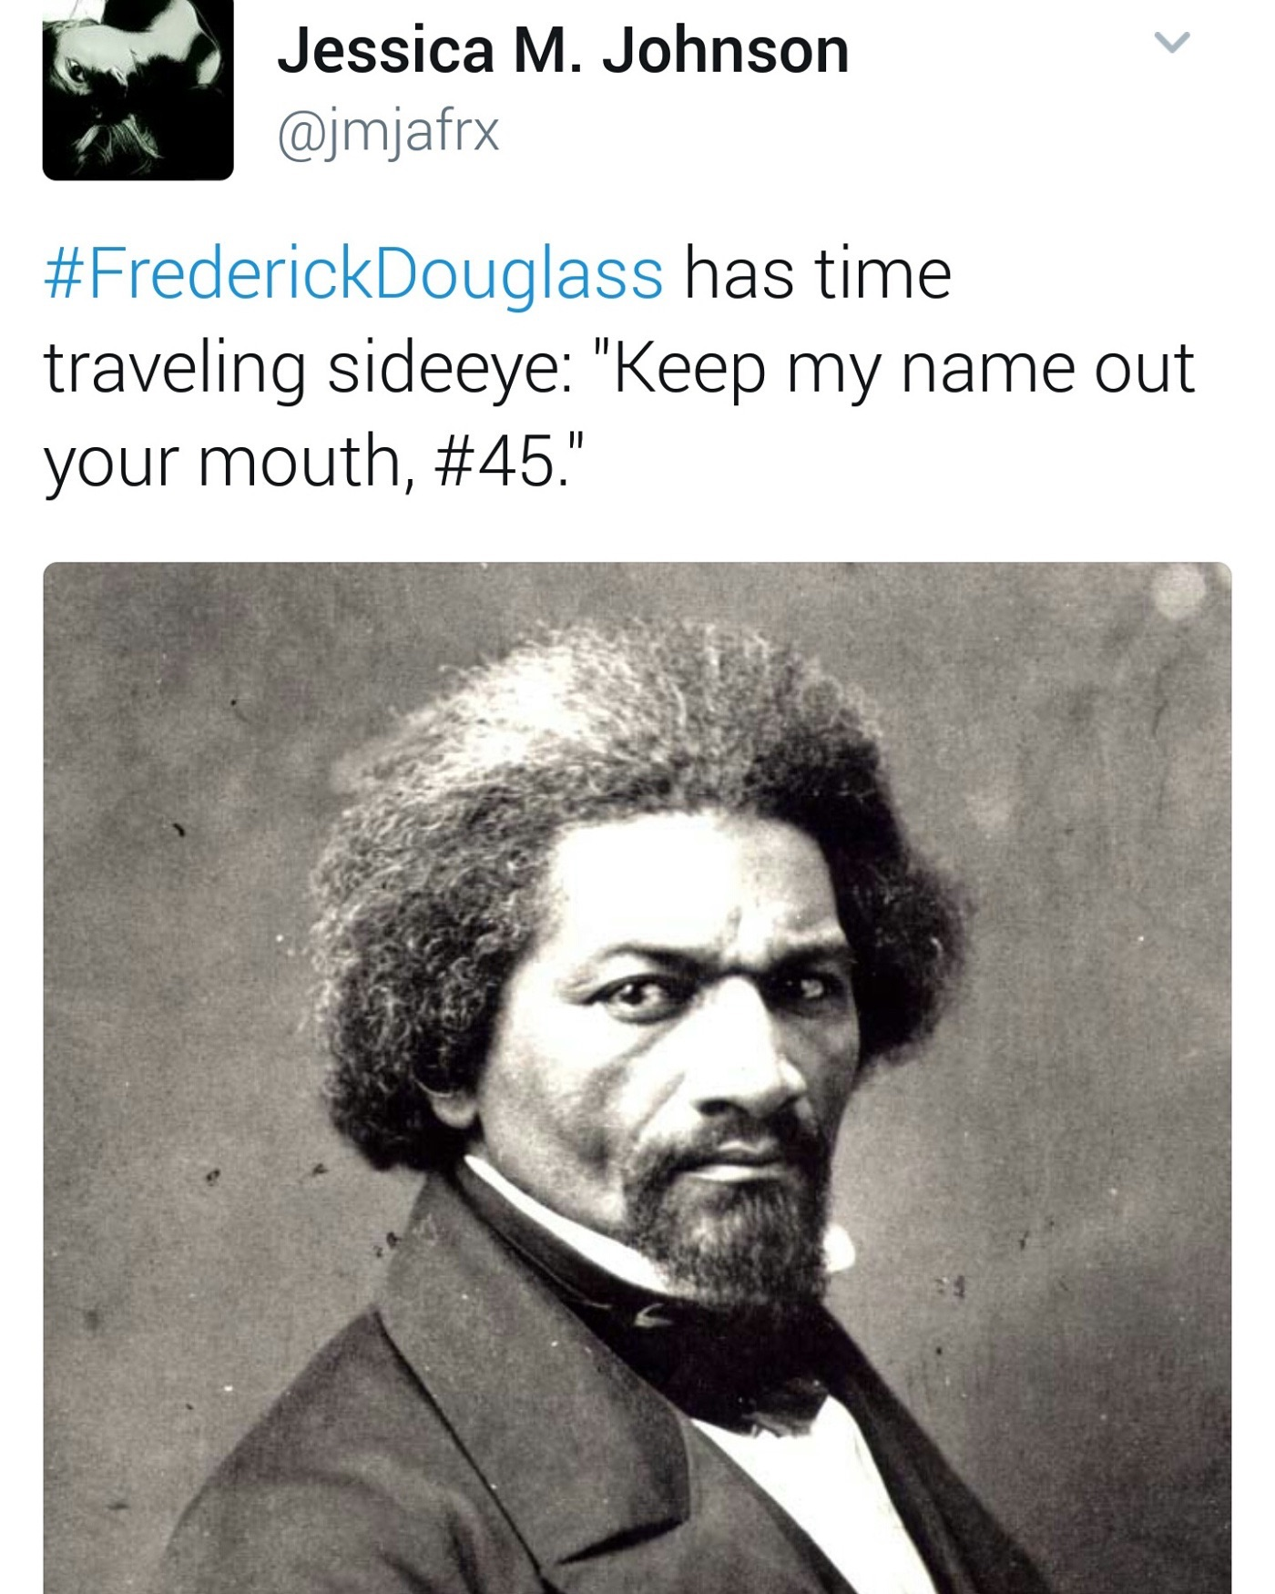
An Amazing Guy
Notes:
https://twitter.com/jmjafrx/status/826835525147435009

Slide 3
How Do We Remember Resistance?
White House Black History Remarks: https://www.youtube.com/watch?v=joxhFaT0VQs
Frederick Douglass and John Brown: American Experience, The Abolitionists, https://www.youtube.com/watch?v=VXM5UWuQbxQ
Douglass:
“A Very pleasing feature of our pictorial relations is the very easy terms upon which all may enjoy them. The servant girl can now see a likeness of herself, such as noble ladies and even royalty itself could not purchase fifty years ago. Formerly, the luxury of a likeness was the exclusive privilege of the rich and great. But now, like education and a thousand other blessings brought to us by the advancing march of civilization, such pictures are placed within easy reach of the humblest members of society.” “Pictures and Progress,” 1863
Frederick Douglass National Historic Site: https://www.nps.gov/frdo/planyourvisit/basicinfo.htm
William Still and John Hawkes

Slide 4
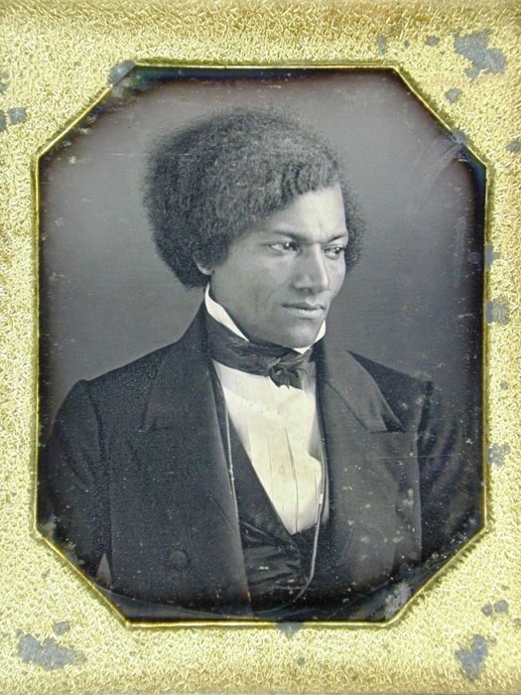
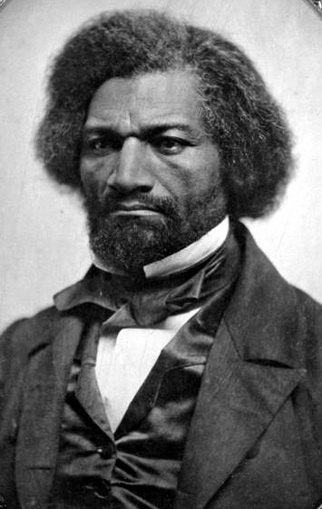
Notes:
Bust portrait of the abolitionist as a young man from a daguerreotype image.Label with image: Frederick A. Douglass presented by him to Susan B. Anthony whose neice, Miss Lucy E. Anthony give it to Albert Cook Myers.In the Albert Cook Myers Historical Collection.DG327

Slide 5
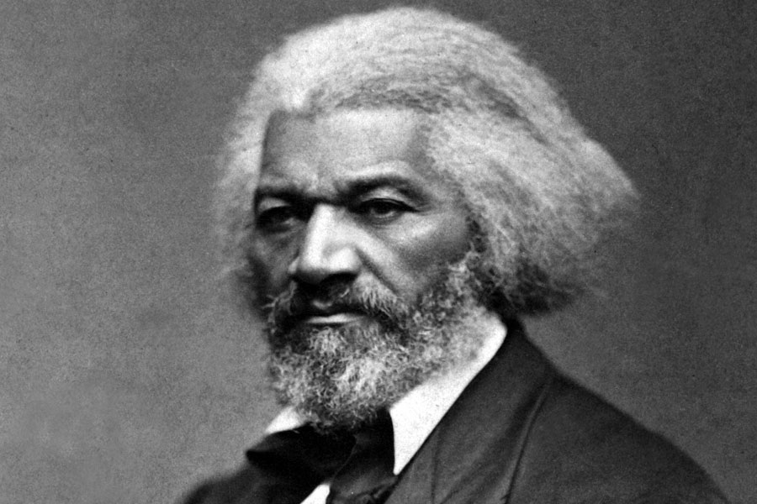

Slide 6
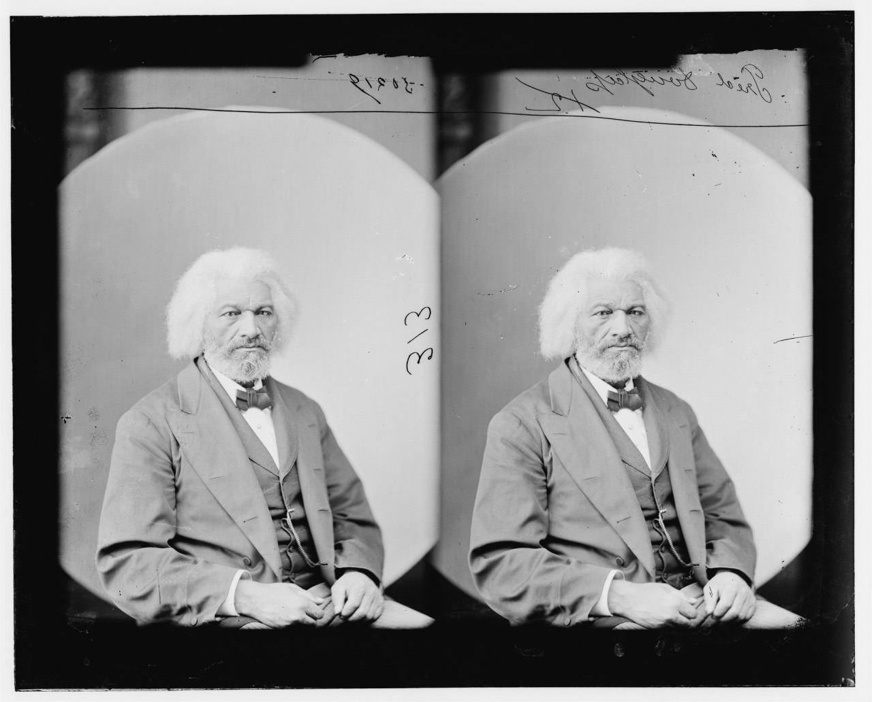

Slide 7
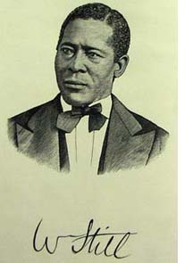
Born: 1821, NJ
Philadelphia: 1844

Slide 8
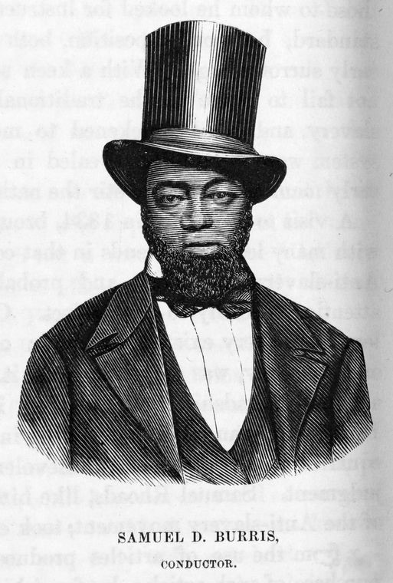
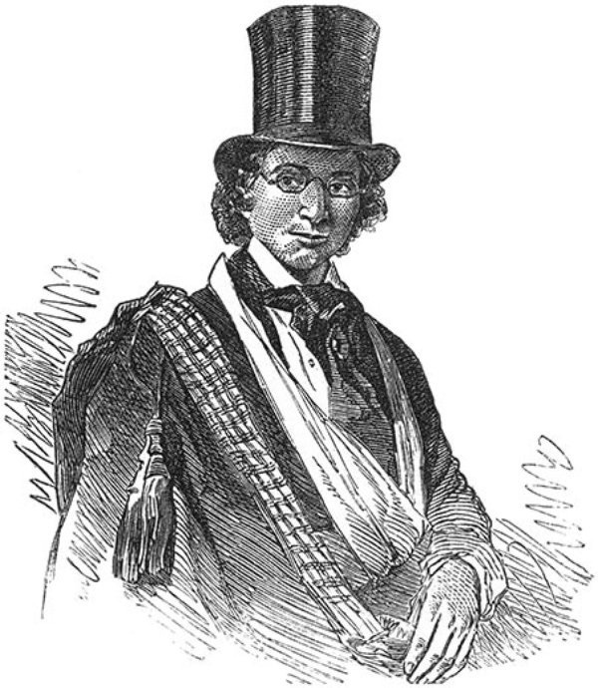
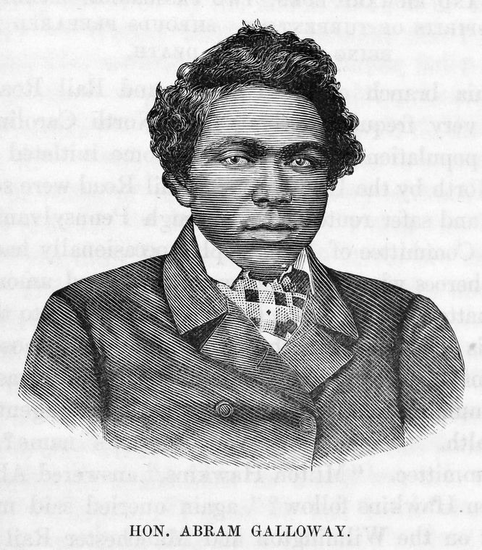
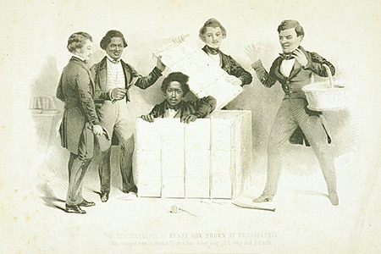
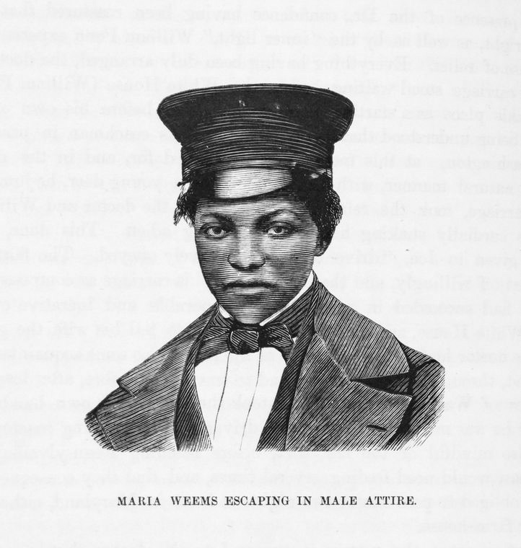

Slide 9
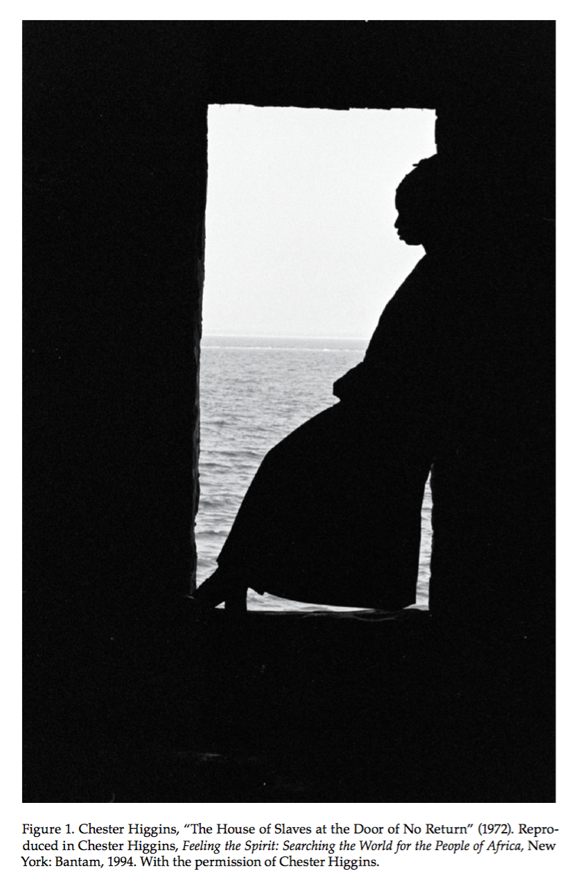

Slide 10
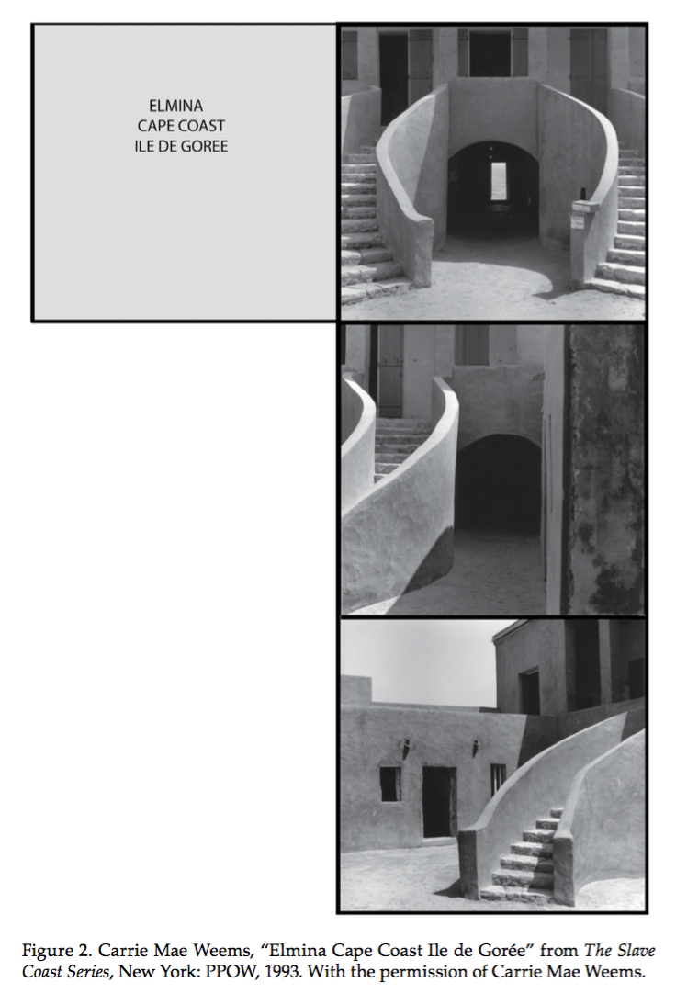

Slide 11
The Only Possible Relationship to the University Today Is a Criminal One
“To the university I’ll steal, and there I’ll steal,” to borrow from Pistol at the end of Henry V, as he would surely borrow from us. This is the only possible relationship to the American university today. This may be true of universities everywhere. It may have to be true of the university in general. But certainly, this much is true in the United States: it cannot be denied that the university is a place of refuge, and it cannot be accepted that the university is a place of enlightenment. In the face of these conditions one can only sneak into the university and steal what one can. To abuse its hospitality, to spite its mission, to join its refugee colony, its gypsy encampment, to be in but not of — this is the path of the subversive intellectual in the modern university.
Harney, Stefano, and Fred Moten. “The Undercommons: Fugitive Study and Black Study.” New York: Minor Compositions, 2013.

